Slide 1
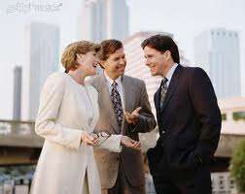
ETHICAL MARKETING
"Ethical Marketing is an honest and factual representation of our services and the business model, delivered in a framework of cultural and social values for the consumer.“
We at GAIN believe “It’s the base for the stable long-term growth of a business.” Hence each GAIN Member has to follow GAIN's Code of Conduct to secure a prosperous future for you & your business associates.
© 2012 - Global Advertising Internet Network – All Rights Reserved

Slide 2
Treat your prospects and business partners fairly
…It is important to treat your prospects fairly at all times –
what goes around comes around...
1. Prohibited Practices
Independent Business Owners shall not use false, misleading, deceptive or unfair sales practices.
Independent Business Owners shall take all necessary and reasonable steps to ensure they and their down-lines do not knowingly make, cause or permit others to make any false or misleading representation relating to the business, company or products on offer.
No omissions of material particulars relating to the business, company or products on offer shall be made or engaged in, knowingly or otherwise.
© 2012 - Global Advertising Internet Network – All Rights Reserved

Slide 3
Speak the truth about your company
…It is important to present your company the way it is, not more and not less – since you will have trouble dealing with the questions that arise from overstatements…
2. Explanation and Demonstration
Opportunity presentations and demonstrations shall be accurate and complete, in particular with regard to product description and benefits. Independent Business Owners shall not provide any misleading monetary claims and benefits in any of their promotional materials in any form whatsoever. All promotional and advertising materials must be strictly compliant with the company's policy and its official approved materials must never be changed.
3. Verbal Promises
Independent Distributors shall not make verbal or other representations concerning the product and compensation plan, except in compliance with No.2 above.
© 2012 - Global Advertising Internet Network – All Rights Reserved

Slide 4
Be available for your customers and partners
Our business is a people’s business based on communication. Be available and open to the questions of your customers and partners and answer them correctly and honestly – if you do so they will take you as an example and automatically grow your business in a fruitful manner…
4. Answers to Questions
Independent Business Owners shall not give any misleading answers to questions from customers and prospects. Frequently asked questions can be found on the GAIN website’s to assist with the before.
© 2012 - Global Advertising Internet Network – All Rights Reserved

Slide 5
Conduct proper marketing
…You are proud of our business and its products. You believe in their value and quality. Present GAIN professionally…
5. Literature
All promotional literature and advertisements shall contain name, address, Independent Business Owners title, phone number, and identification Number.
Promotional literature and advertisements shall not contain any description, claims or illustrations that are deceptive or misleading.
© 2012 - Global Advertising Internet Network – All Rights Reserved

Slide 6
Speak your heart
…Honesty reaches out to others more effectively. Stay with the correct facts when you use testimonials about the business and the products. Make sure that every statement is reflecting reality – in doing so your business will flourish…
6. Testimonials
Independent Business Owners shall not refer to any testimonial or endorsement that is not authorized, not true, or otherwise no longer applicable, or used in any way likely to mislead the customer.
© 2012 - Global Advertising Internet Network – All Rights Reserved

Slide 7
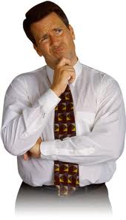
No place for ‘soldiers of fortune’
…Some business people are lucky but that is not the case for the majority. Nobody should start off in our business with an expectation that they don’t need to do anything to gain wealth.
$
$
$
7. Disclaimer and Limitation
Everybody should be informed about our Disclaimer & Limitations. Working with real people will bring you the best results.
© 2012 - Global Advertising Internet Network – All Rights Reserved

Slide 8
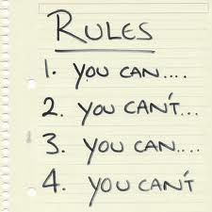
Stick to the rules
…Every business follows certain rules. Rules are important to give you freedom to build your business on solid ground.
Inform your partners about regulations of the business and you will see that a strong foundation will give our organisation wings to fly…
8. Policies & Procedures
Independent Business Owners shall act and comply at all times with the Company’s Policies & Procedures (P & P), which apply to them.
© 2012 - Global Advertising Internet Network – All Rights Reserved

Slide 9
Render Clear Guidelines to Your Business partners
…The easiest way of leadership is being a good example for others. If you talk down on other companies or their products, you talk down on yourself. Let others do their business and speak positive about other companies…
9. Comparison and Denigration
Independent Business Owners shall refrain from using comparisons that are likely to mislead and which are incompatible with principles of fair competition. Points of comparison shall not be unfairly selected and shall be based on facts that can be substantiated. Independent Business Owners shall not unfairly denigrate any firm or product directly or by implication. Independent Business Owners shall not take unfair advantage of the goodwill attached to the trade name and symbol of another firm or product.
© 2012 - Global Advertising Internet Network – All Rights Reserved

Slide 10
Maintain a professional and respectful attitude
Don't let your enthusiasm for the business corrupt your good manners. When you respect others they will do the same and be loyal partners…
10. Respect of Privacy
Personal or telephone contact shall be made in a reasonable manner and during reasonable hours to avoid intrusion. Independent Business Owners shall discontinue a demonstration or sales presentation upon the request of the consumer.
© 2012 - Global Advertising Internet Network – All Rights Reserved

Slide 11
Shoulder your responsibility
…Approaching prospects or working with new partners requires your full potential and responsibility. Take care of your partners and prospects and treat them equally and fairly. The more empathy shown, the better you can utilise the qualities of your business partners. This will make your partners grow – along with your growth…
11. Fairness
Independent Business Owners shall not abuse the trust of individual consumers and shall not exploit a consumer's age, illness, lack of understanding, or lack of language knowledge.
© 2012 - Global Advertising Internet Network – All Rights Reserved

Slide 12
Income and Earnings
GAIN's business is not a 'get rich quick scheme'.
There is no guarantee, promise, representation or warranty that you will make a certain level of income. You accept the fact that earnings and income statements differ by individual, as the nature of this business and the level of earning are both strongly connected to a person's personal efforts, diligence, dedication, motivation and personal skills. Once your prospects understand this, you avoid disappointment and at the same time, you create a solid working culture within your organization.
© 2012 - Global Advertising Internet Network – All Rights Reserved

Slide 13
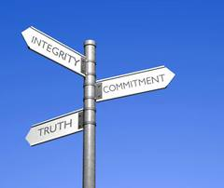
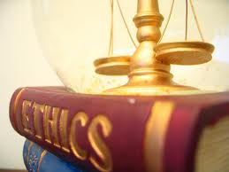
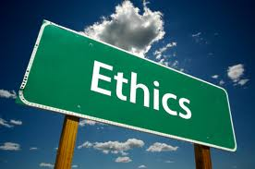
Enforcement of Code of Conduct
GAIN’s Code of Conduct and ethical marketing guidelines ensure fair business practices by regulating the relations and dealings between Independent Business Owners, as well as between Independent Business Owners and their prospects and/or customers. These ethical guidelines must at all times be observed, adhered to, and strictly followed. Any violation will result in due inquiry and/or disciplinary proceedings being taken against the individual(s) concerned, which can result in show cause action, suspension and/or termination of the status as an Independent Business Owner. Independent Business Owners must familiarize themselves with the actual terms of ethical marketing and the Code of Conduct on GAIN websites at www.gain2umatrix.com, www.gain2unetwork.com, www.gain-global-trader.com and are formally directed to do so. Independent Business Owners are encouraged to report any violation of the Code of Conduct to their up-line.
© 2012 - Global Advertising Internet Network – All Rights Reserved

Slide 14
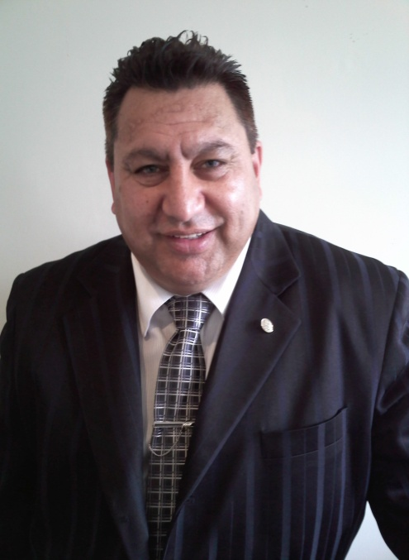
Contact us Today!
If you have any questions regarding
ethical marketing, please contact
gain2u.nz@gmail.com
Gavin Marsich
© 2012 - Global Advertising Internet Network – All Rights Reserved

